Slide 1
Final Project: Instacart Market Basket Analysis
RONAK SOMANI
INSTRUCTOR: PROF. JUSTIN GROSZ

Slide 2
DATASET DESCRIPTION
In the recent years, analyzing shopping baskets turned out to be very appealing to retailers. Sophisticated technology made it possible for them to collect information of their customers and what they purchase. In retail business, analyzing such information is exceedingly valuable for understanding purchasing behavior.
Instacart, a grocery ordering and delivery app, for on-demand grocery shopping with same-day delivery service, aims to make it easy to fill refrigerator and pantry with personal favorites and staples when needed.
Instacart uses transactional data to develop models that predict which products a user will buy again, try for the first time, or add to their cart next during a session.
After selecting products through the Instacart app, personal shoppers review the order and do the in-store shopping and delivery for customers.
There are three ways that Instacart generates revenue: delivery fees, membership fees, and mark-ups on in-store prices.

Slide 3
DATA SOURCE AND DATASET INFORMATION
I have collected the dataset from “The Instacart Online Grocery Shopping Website”. And it can be downloaded from the link mentioned below: https://www.instacart.com/datasets/grocery-shopping-2017
This dataset is a relational set of files describing customers’ orders over time.
The dataset is anonymized and contains a sample of over 3 million grocery orders from more than 200,000 Instacart users.
For each user, we provide between 4 and 100 of their orders, with the sequence of products purchased in each order.
We also provide the week and hour of day the order was placed, and a relative measure of time between orders.
This dataset includes orders from many different retailers and is a heavily biased subset of Instacart’s production data.

Slide 4
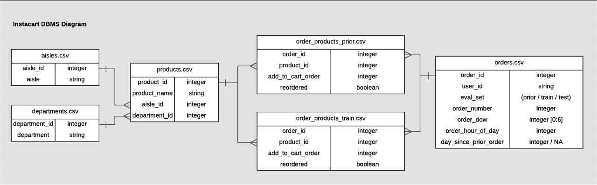
Visual Relationships between Instacart Data Files

Slide 5
BUSINESS PROBLEM AND TECHNIQUE
The objective for this project is to use anonymized data on customer orders over time to predict which previously purchased products will be in a user’s next order and also to demonstrates a detailed analysis of Instacart Market Basket.
Can we form users into different groups based on the products they ordered, the time of their orders and if they reordered or not?
The goal is to find specific relationships or structure in the input data that allow us to effectively produce correct output data.
Predict the length of time since the previous order and the fraction of previous orders on which the item was bought.
With ever increasing cost of acquiring new customers and increasing competition, leveraging existing customer is the best option at the disposal of businesses. The best solution for this turns out to be analyzing using big data techniques.

Slide 6
DATA CLEANING AND ADDITIONAL REWORK
The following dataset requires additional rework, in “orders, products, aisles, departments”, structure of some features are wrong type, we need to do some recoding and convert variables to factors.
It can be noticed in “orders” csv file that only column with “days_since_prior_order” has NA values summing up to 206209, which is approximately equal to 6% of the total. Also, it is equal to total of “user id”, so it can be assumed that every user has at least one missing record entry.
By analyzing the data, it can be noticed that almost NA values of “days_since_prior_order” have “eval_set” at prior, and “order_number” at 1. The percentage 6% of missing value is big because Prior factor which relate to Na’s values of “days_since_prior_order” is the biggest part in “eval_set”. Hence, the missing values could not be dropped. We will explore their interaction.

Slide 7
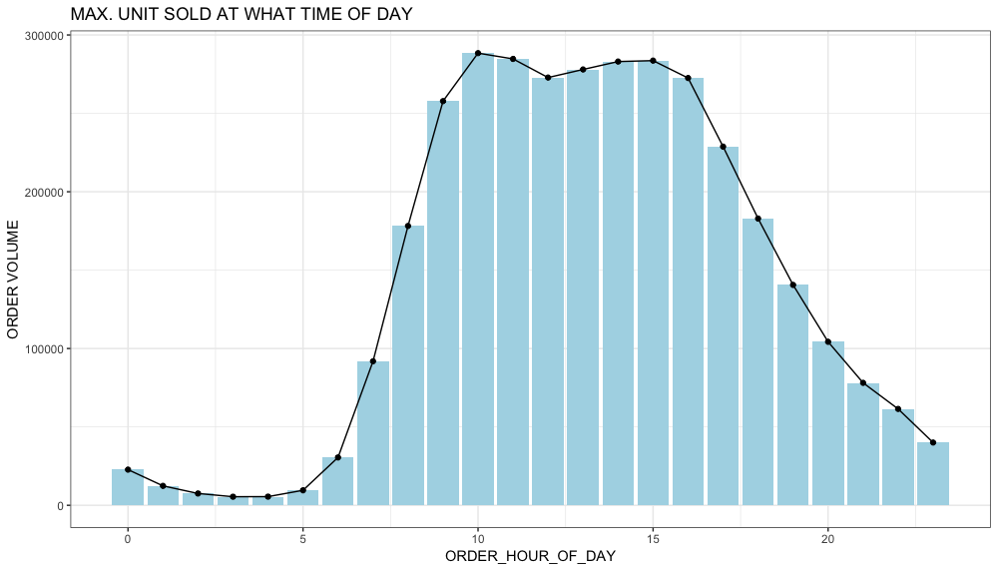
Exploratory Data Analysis
1. What time of the day do people order the highest selling products?
From the plot it can be stated that, there is a clear effect of hour of day on order volume. Most orders are between 8.00-18.00 hours. Also, the hour at which the maximum number of orders placed is 10AM which is approximately equals to 2874905 orders which is when people usually state their meal and day. Instacart can accordingly plan to hire persons for delivery during days shifts.

Slide 8
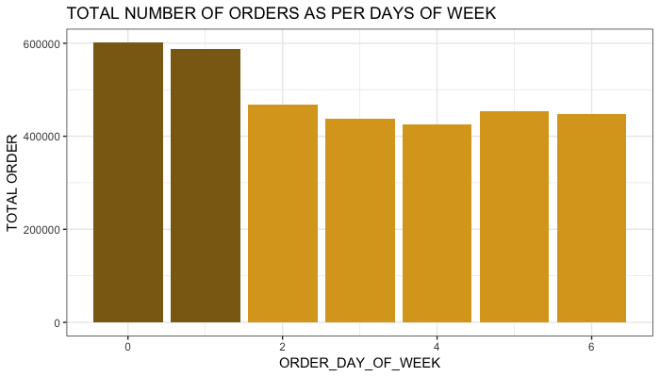
Exploratory Data Analysis
2. On which day do people order the highest selling products?
This analysis shows on what day of the week are the products being sold the highest, clearly Sunday (which is represented by “0”) and Monday (which is represented by “1”) are when there is highest sale in the products which means that this analysis shall help the retailers restock their stock by Saturday (which is represented by “6”) night for better sales and growth.

Slide 9
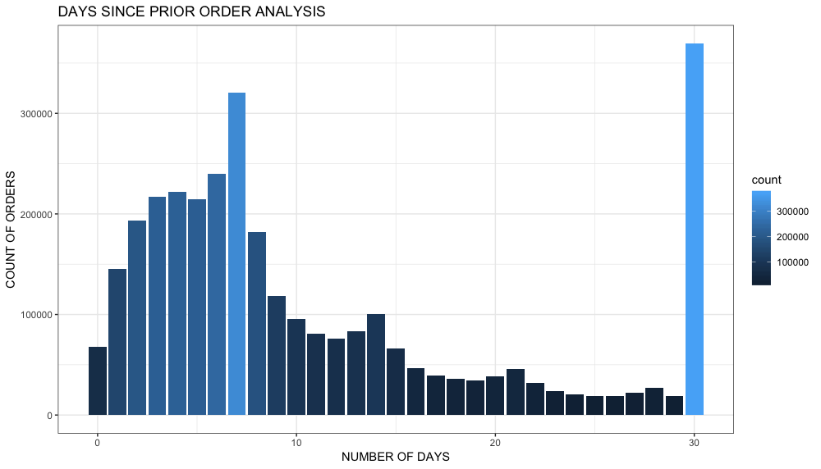
Exploratory Data Analysis
3. When do customer reorder since prior order day?
This analysis shows us the usual reordering frequency of consumers who order through Instacart, looking at the Bar plot above, we can deduce that people seem to order more often after exactly 1 week and once a month (peaks at 7th and 30th day of a month) which shows weekly intervals.

Slide 10
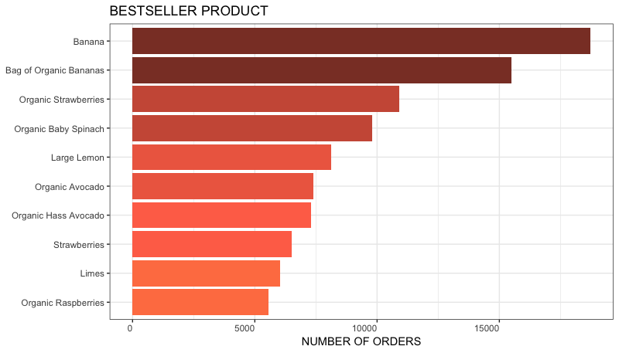
Exploratory Data Analysis
4. What are the top 10 maximum sold product from market basket?
From the horizontal bar plot, it can be clearly stated that “Bananas” and “Bag of Organic Bananas” stands out as the top products in terms of highest sales. So, we can recommend Instacart to always maintain the stock of these products as they are more in demand.

Slide 11
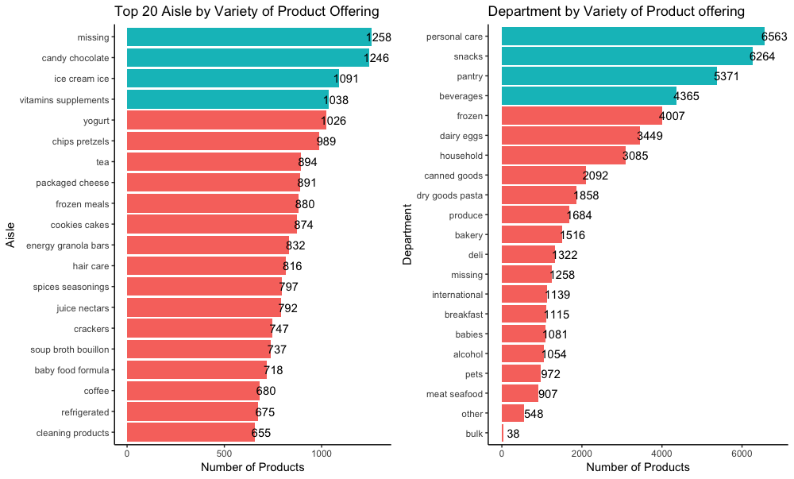
Exploratory Data Analysis
5. What are the top 20 aisle and department by variety of products?
From the bar plots of top 20 aisles by variety of products, it can be deduced that Missing, candy chocolate, Ice cream ice and vitamin supplements aisle are the aisles with maximum variety of products. Moreover, it can be inferred from the below bar chart of department by variety of products offering that Instacart has maximum number of product offerings across personal care and edible item departments.

Slide 12
MODELING TECHNIQUES
I applied logistic regression model to examine the relationship between one or more independent variables on a dependent variable.
Regression analysis provides detailed insight that can be applied to further improve products and services.
I made two models using logistic regression taking account of two predictors:
like the length of time since the previous order and the fraction of previous orders on which the item was bought for 1st model and,
which user reorder or what product has the best chance for reorder, or which particular order is repeated for 2nd model.

Slide 13
INSIGHTS FROM THE 1st MODEL
The raw data is spread across 7 tables and isn't amenable to standard classification algorithms. To create a tractable data set, for 1st model there was a need to get the data into a particular form to do this; we need to make a data frame with the following columns: order_id, previous items ordered by the user, fraction of previous orders the user bought this item, how many days was it since the previous order? and did the user buy it this time yes/no?
This model outputs an updated “probability” of a certain item being in an order which is an increasing function of the fraction of prior orders and a decreasing function of the time since the previous order was made — the longer a user waits between orders, the less likely it is that they will buy something!

Slide 14
INSIGHTS FROM THE 1st MODEL
Using these estimates of the regression coefficients, I’ve defined a function to give the response for a given value of frac and days_since_prior_order. I made a plot of the response as a function of frac.
It shows how it varies with the number of days—the impact of days_since_prior_order is small but not negligible.

Slide 15
INSIGHTS FROM THE 2nd MODEL
For 2nd model, I used 20% of the total data and after loading these files I cleaned the data by changing the variable types. I build the model only on the prior dataset and to cross-validate it. I used train dataset results. We are going to want data specific to each user, each product, and each user-product interaction.
For example, adding user specific features and finally adding the `test` and `train` orders for each user to the users table to be used later for predictions and in separating of cross-validation and test prediction sets.
I joined all of the feature tables and currently only considering possible products that a user can order from the products they have already ordered. Finally created training and testing data for running logistic regression model on the above-mentioned data frame.

Slide 16
INSIGHTS FROM THE 2nd MODEL
From the logistic regression plot, it can be deduced that the model is a perfect fit as the probability is between 0 and 1 for the predicted values.

Slide 17

FEATURE EXTRACTION ANALYSIS - Can we cluster users into different groups based on the products they ordered, the time of their orders and if they reordered or not?
I performed user clustering to categorize users based on their shopping behavior.
I choose K-means clustering because it provides a clear and straightforward visualization of the groups.
The variables used to cluster users include what products they ordered, during what time of the day they placed the order, the order of products they added the cart, if the user has reordered and how many days the user reordered i.e., I categorized users into 5 clusters.
First plot is of product_id on the x-axis and order_hour_of_day on the y-axis.
Then I plotted add_to_cart_order and days_since_prior_order.

Slide 18
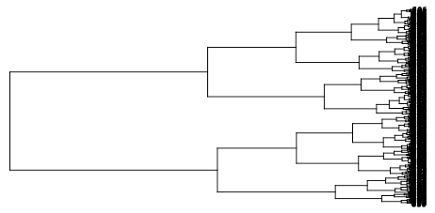
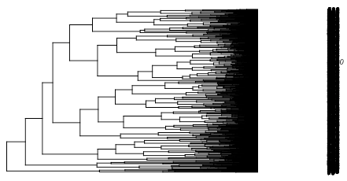
FEATURE EXTRACTION ANALYSIS - hierarchical clustering (bottom_down) for the users
I chose this method because it provides a good visualization of the different levels and how the clusters are made. The variables we are going to use to cluster is reordered users.
1st plot shows clustered based on the unnormalized variables.
2nd represents clustered based on the normalized variables.
Even though the hierarchical clusters are very dense, I can still compare the differences between the unnormalized and normalized one. For the unnormalized graph, it is clear that there are a few dominant variables that divide the groups. On the other hand, for the normalized graph, it's a combination of many little things.

Slide 19
Overall, the hierarchical cluster are hard to read because one user has many characteristics and it is hard to plot all of them in one clear tree. The hierarchical cluster might be more useful for products other than users. The K-means gives a good and clear clustering of the users. Furthermore, the purpose of using K-means and Hierarchical clustering techniques is to find out which is more suitable for clustering the users and products into categories.

Slide 20
Recommendations for the Organization
These analyses can be used to run promotional and marketing campaigns targeting specific customers during peak time.
Personalized communications can be sent to customers’ preferences, reminding them to order again.
To improve customer satisfaction by timely delivery and reduce wait time, the shopper base can be increased by hiring new shoppers who can especially work around the peak time.
Based on analysis of the data set we can recommend the best product fitting the consumers need which will save their time as well as efforts also, not only it will help the consumers for easy checkout but also by predicting this user based purchase, retailers could run an inventory check stocking the most used department to retain their consumers which would act as a source for their commercial and organizational benefits.
Organization would be able to help and recommend the customers that which product they should buy with the product already present in their cart. For example, users buying product like Baby diapers from the baby department would also like to buy baby shampoo or other products for a baby.

